Slide 1


Superconductivity in $θ=3.65°$ tWSe2
Mu-Yang Chen(陈沐阳)
International Center for Quantum Materials, Peking University
Advisor: Jiabin Yu（于家斌） B.A.Bernevig
Defense Advisor: Zhida Song(宋志达）
本科生毕业答辩,北京,05/19/2025

Slide 2
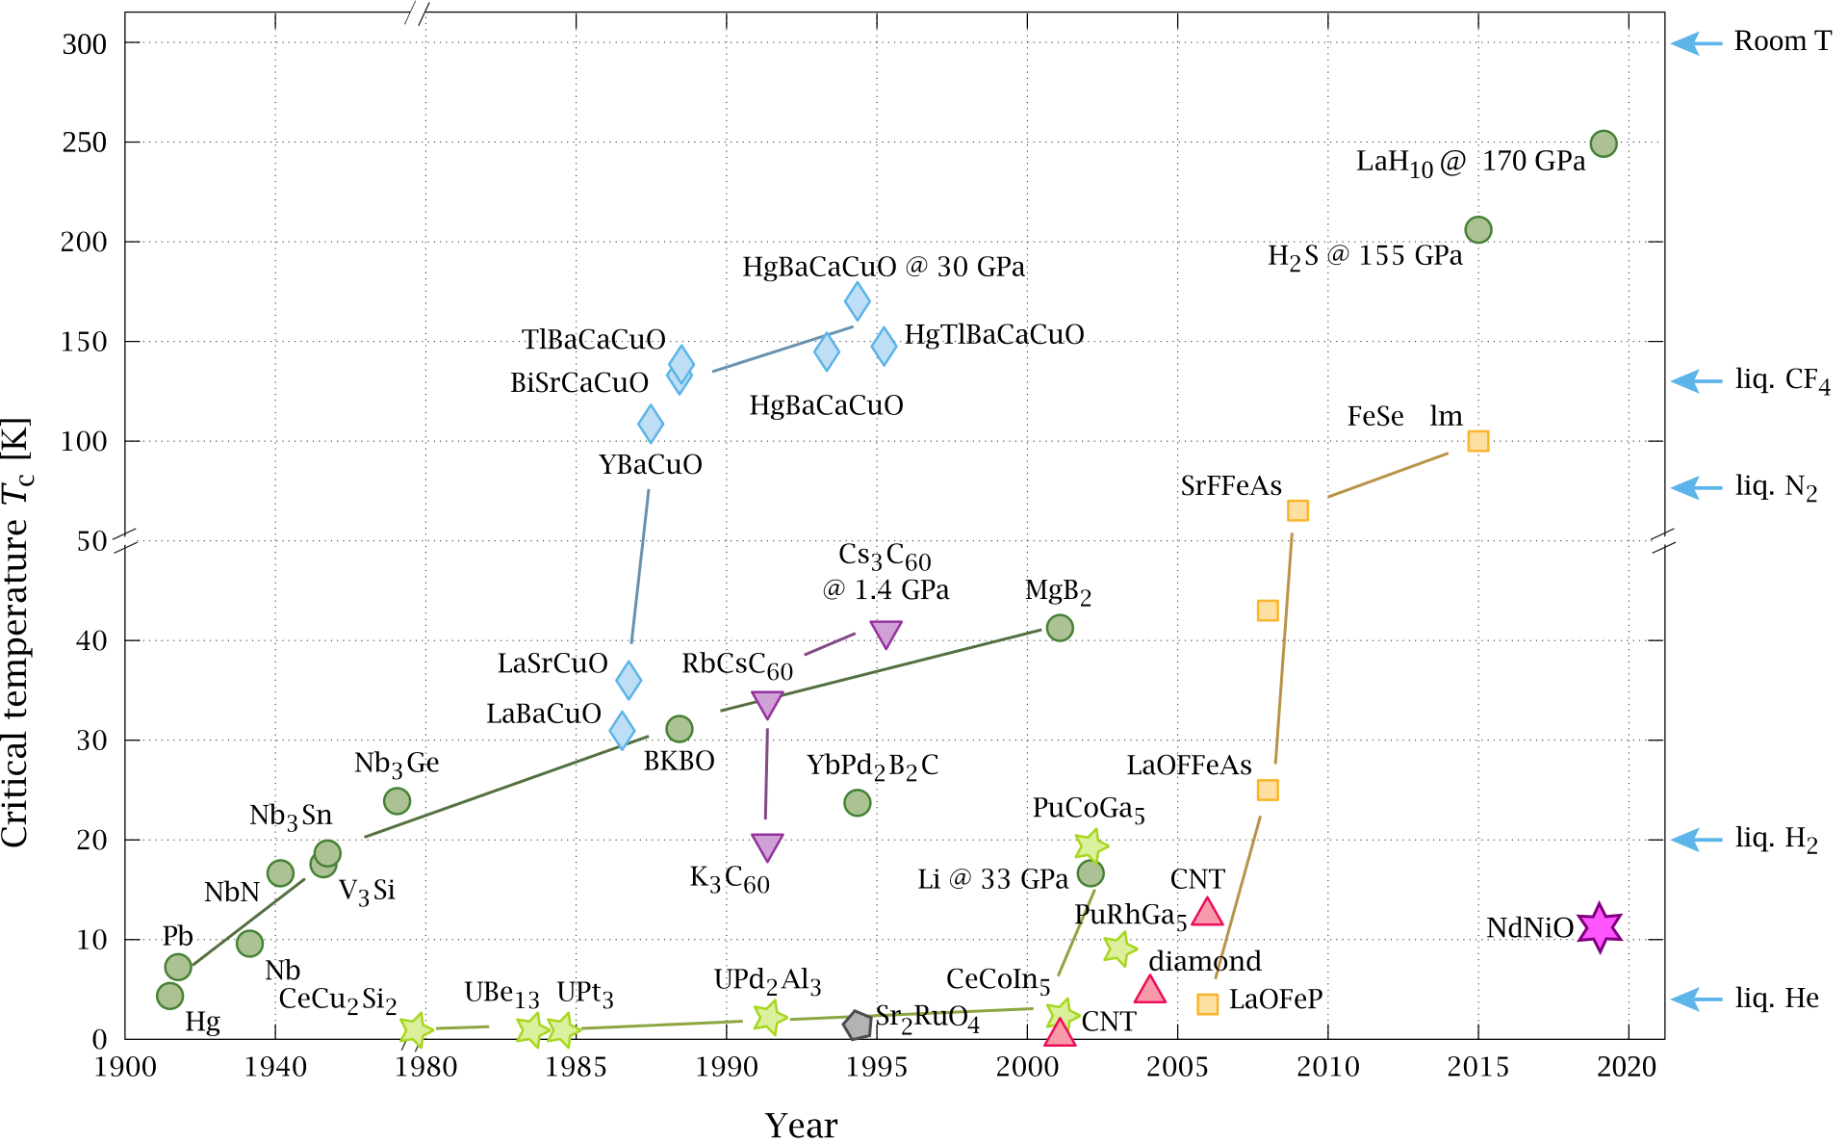
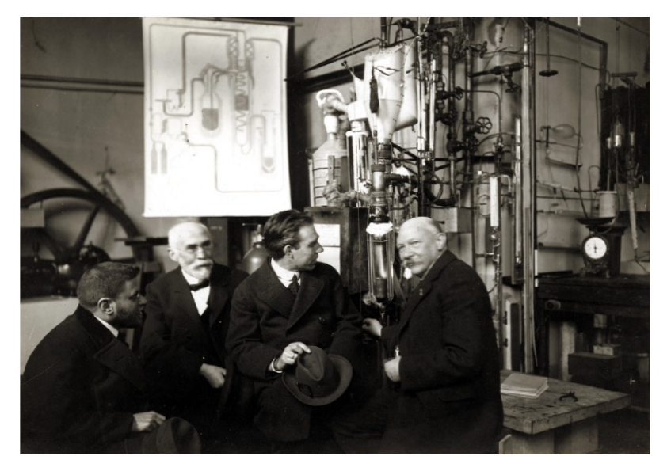
Introduction
(a) Discovery of Superconductors
(b) P. Ehrenfest, H. Lorentz, N. Bohr and H.Onnes,Leiden (1919)
Superconductivity: Cornerstone of modern physics and technology

Slide 3
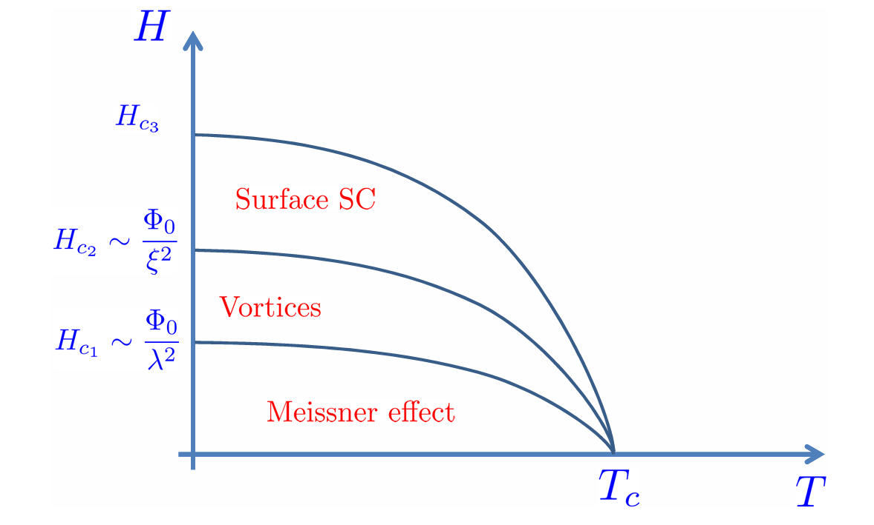
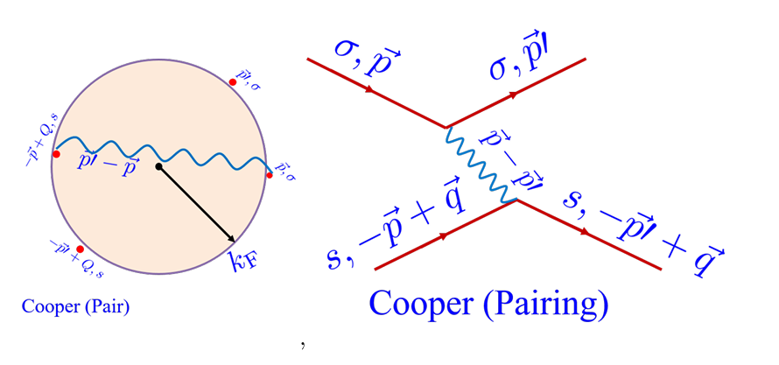
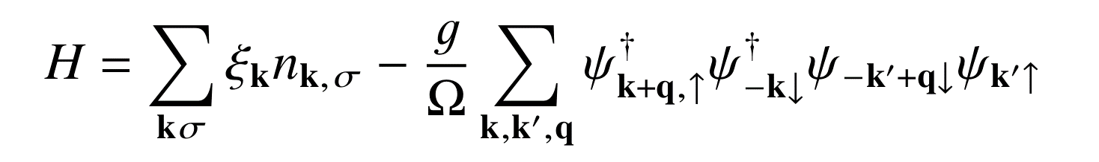

Introduction
(a) Cooper Pairing
(b) Phase Diagram
$$T_{c}=Cω_{D}e^{−\frac{1}{gN\left(ε_{F}\right)}}$$
BCS Superconductors: Large DOS/Debye frequency, long range ordered

Slide 4
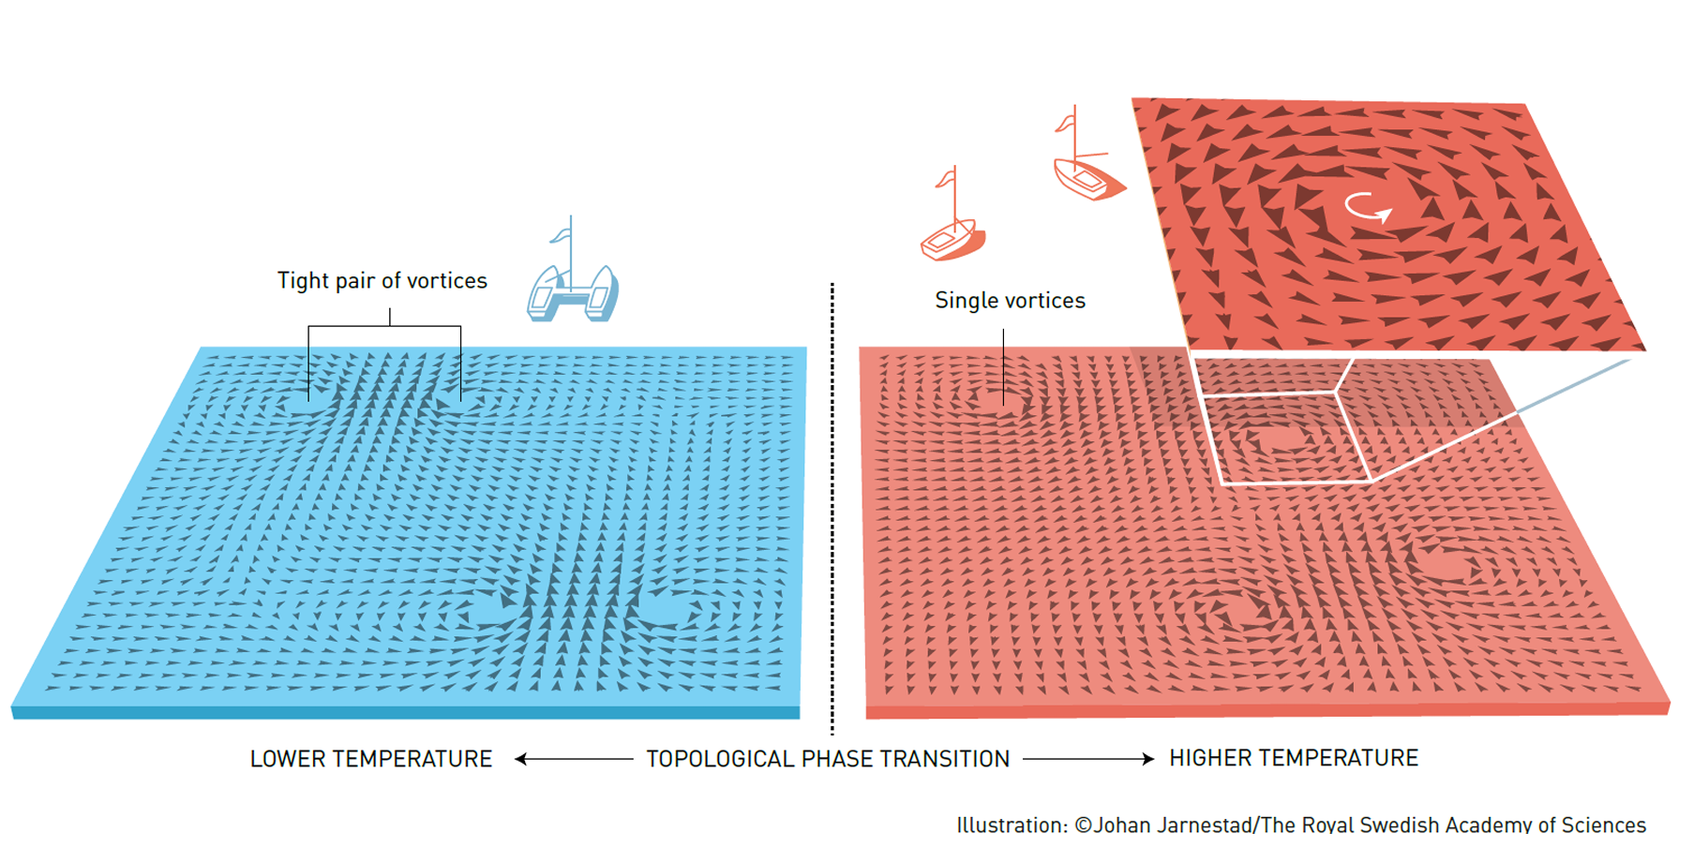
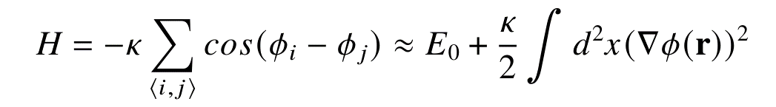

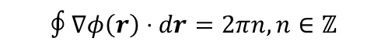
Introduction
$$∮∇φ\left(r\right)⋅dr=2πn, n∈ℤ$$
$$T_{KT}=\frac{π}{2}κ$$
BKT Superconductors: Topological defects, quasi long range ordered

Slide 5
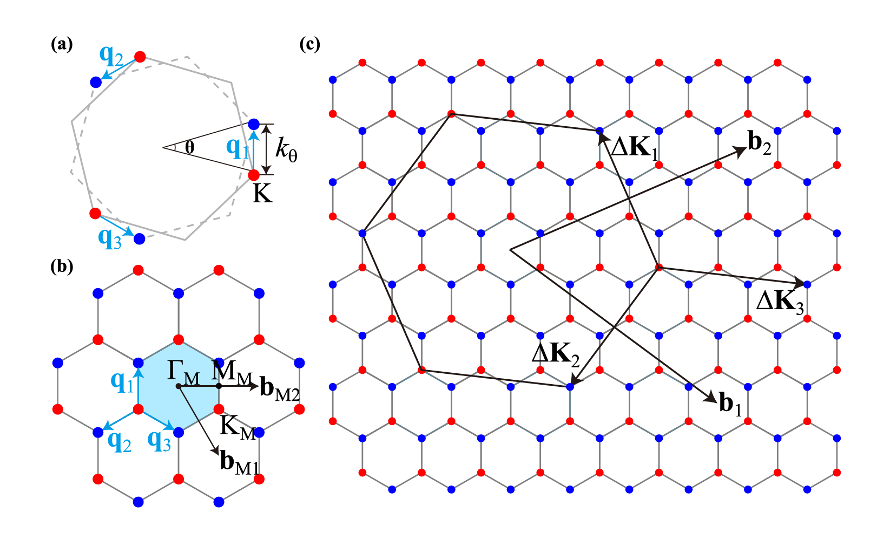
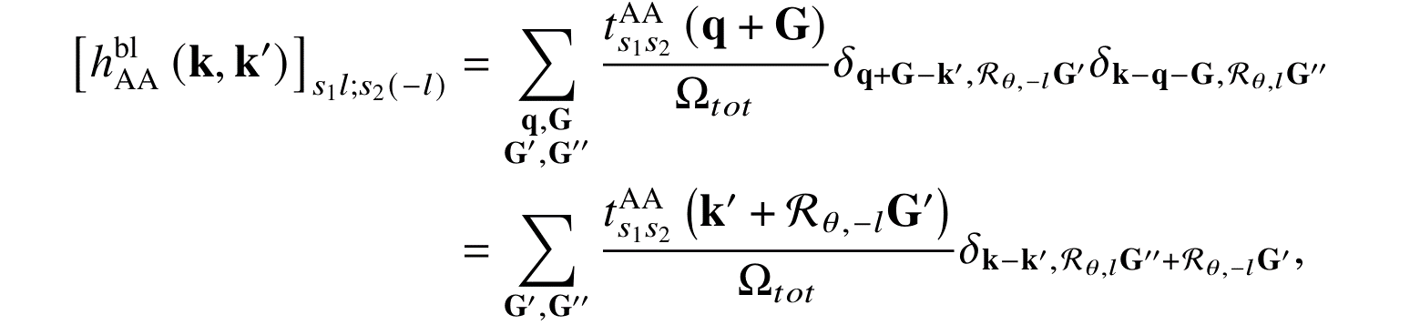
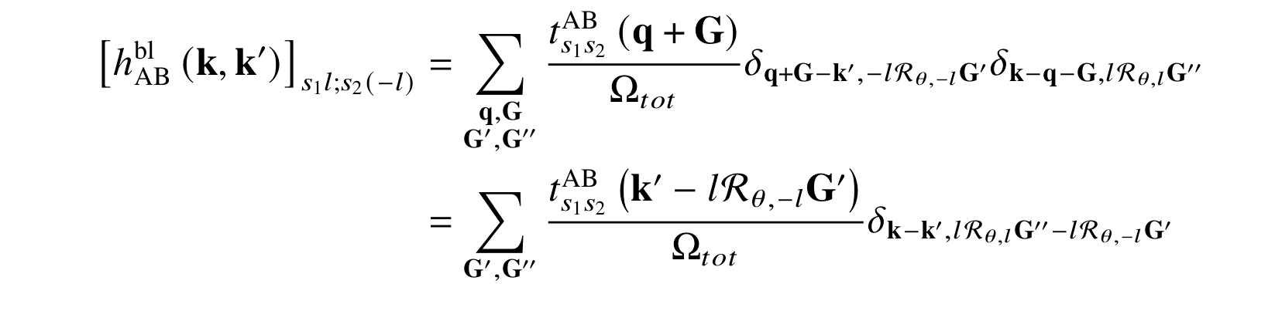
Model
Moiré Superlattice*
Continuum Model:
Commonly used approach: two-center approximation
Another approach: symmetry-guided modeling More Intuitional!!
*https://doi.org/10.1103/PhysRevB.103.205411

Slide 6
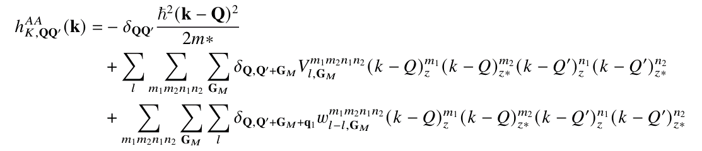
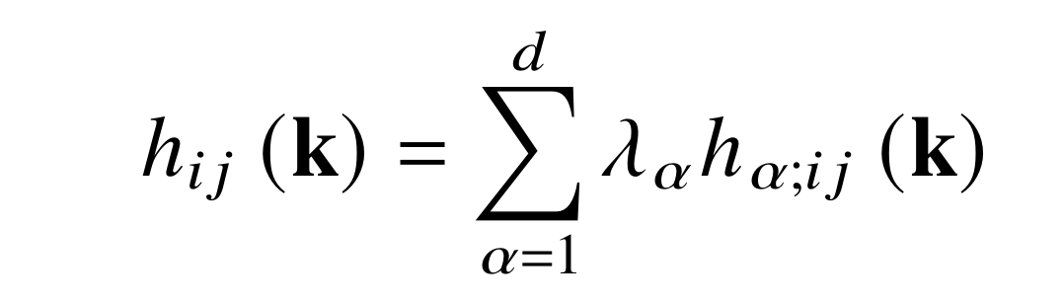
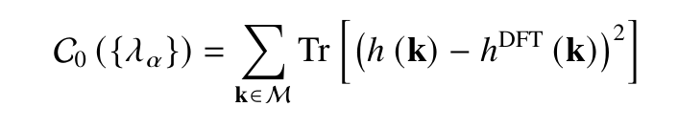
Model
DFT Model:
The model is based on ab-initio calculations*
Linear extraction: higher precision and no need for fitting
*https://doi.org/10.48550/arXiv.2411.18684

Slide 7
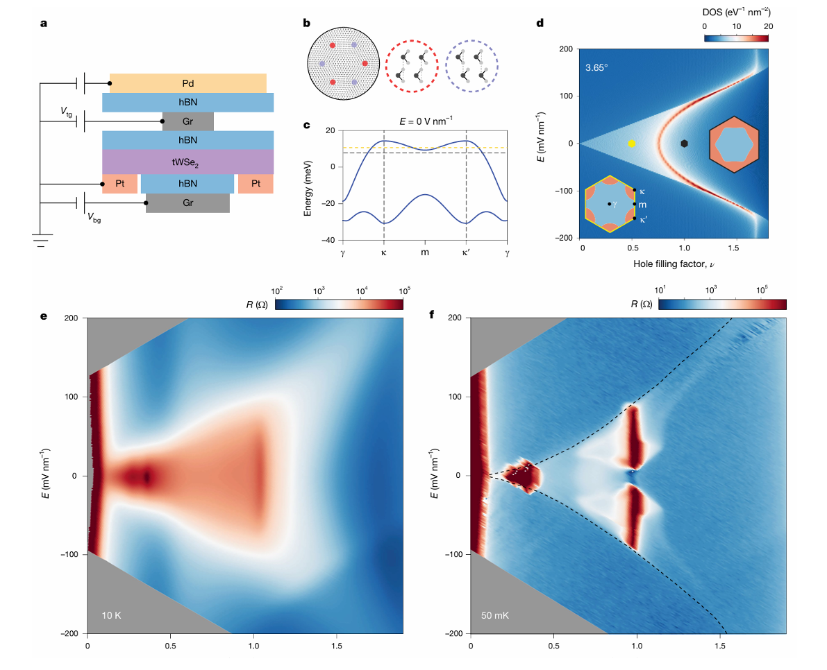
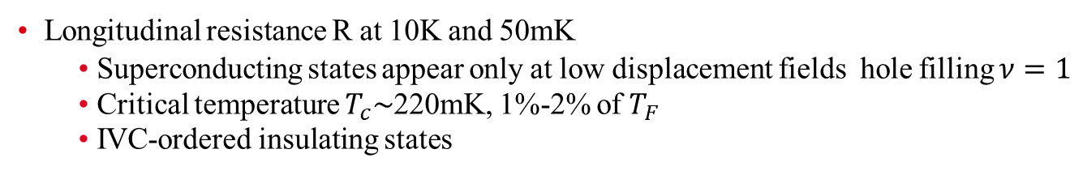
Experiment
Longitudinal resistance R at 10K and 50mK
Superconducting states appear only at low displacement fields hole filling $ν=1$
Critical temperature $T_{c}\sim$220mK, 1%-2% of $T_{F}$
IVC-ordered insulating states
*https://doi.org/10.48550/arXiv.2405.14784

Slide 8
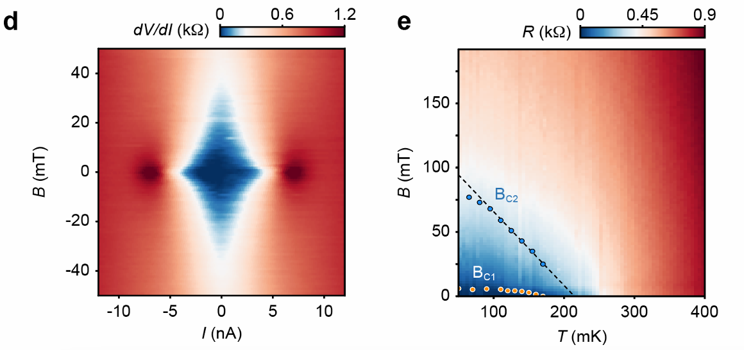
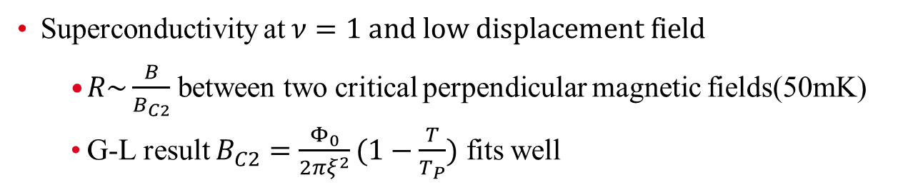
Superconductivity in tWSe2*
Experiment
Superconductivity at $ν=1 and low displacement field$
$R\sim \frac{B}{B_{C2}}$ between two critical perpendicular magnetic fields(50mK)
G-L result $B_{C2}=\frac{Φ_{0}}{2πξ^{2}}(1−\frac{T}{T_{P}})$ fits well
*https://doi.org/10.48550/arXiv.2405.14784

Slide 9
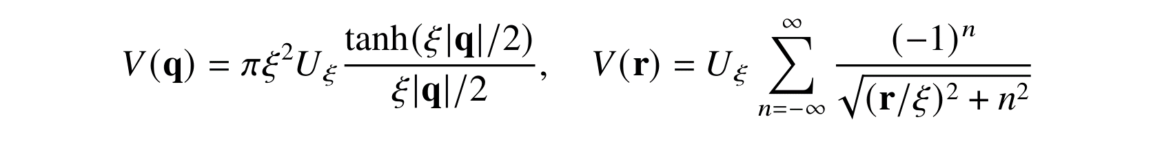
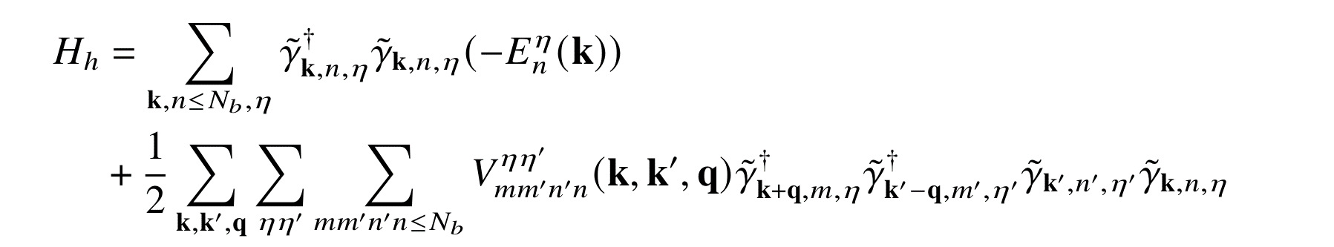
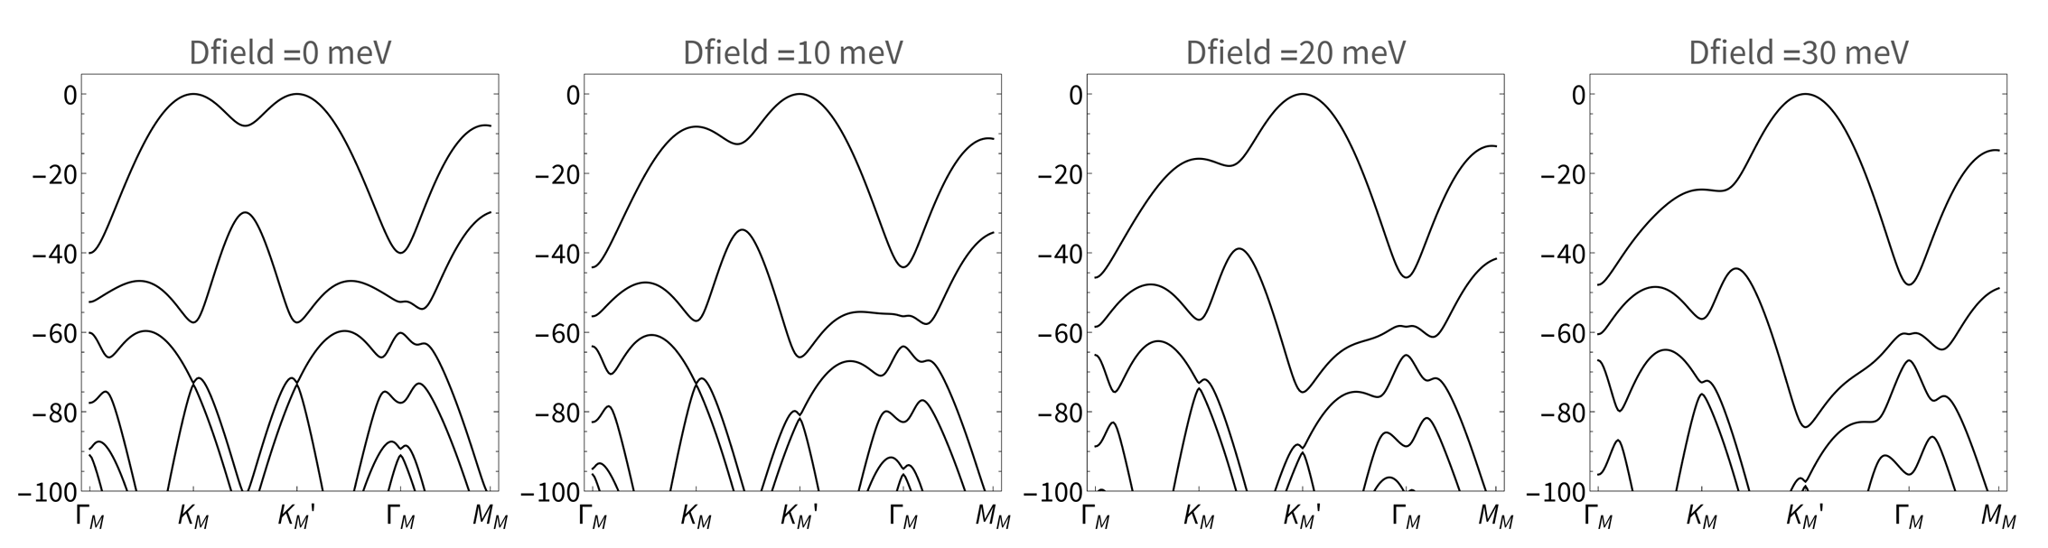
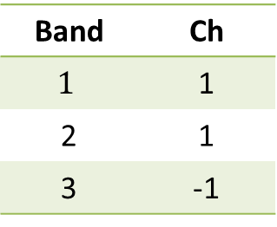
Result
Band | Ch
$$1$$ | 1
2 | 1
3 | -1
Apply band projection to the hole Hamiltonian

Slide 10
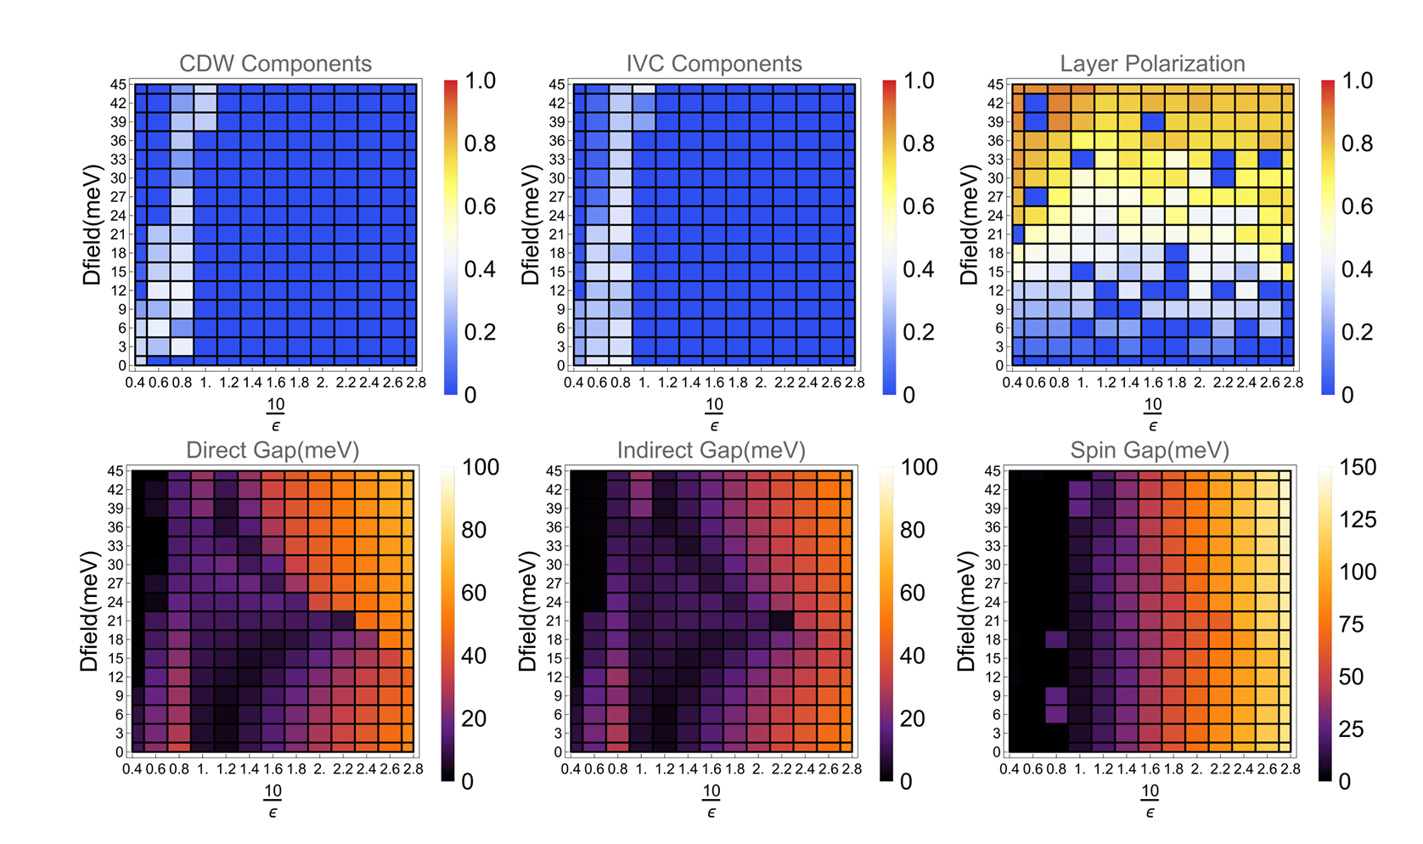
Result
Phase Diagram:
Translational symmetry breaking: CDW, IVC order, IKS order
Observation of IVC-ordered correlated insulators

Slide 11
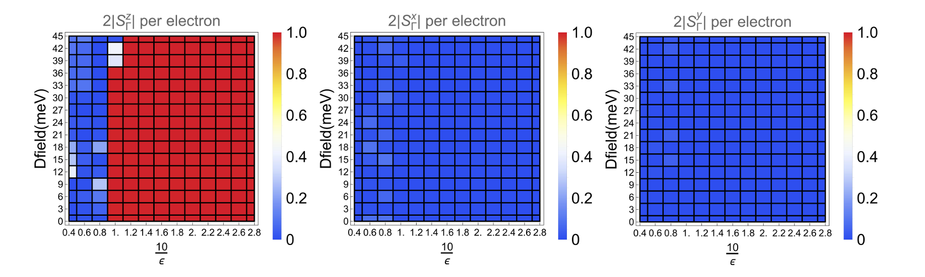
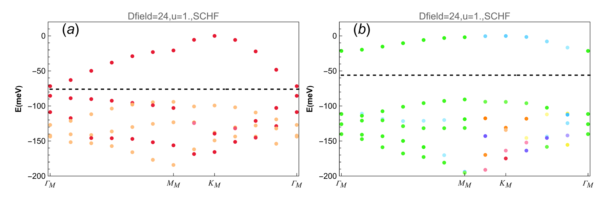
Result
Phase Diagram:
Weak interaction: translational symmetry breaking
Strong interaction: U(1) symmetry breaking Valley polarized states
Benchmark: 2BPV Hartree-Fock band structures

Slide 12
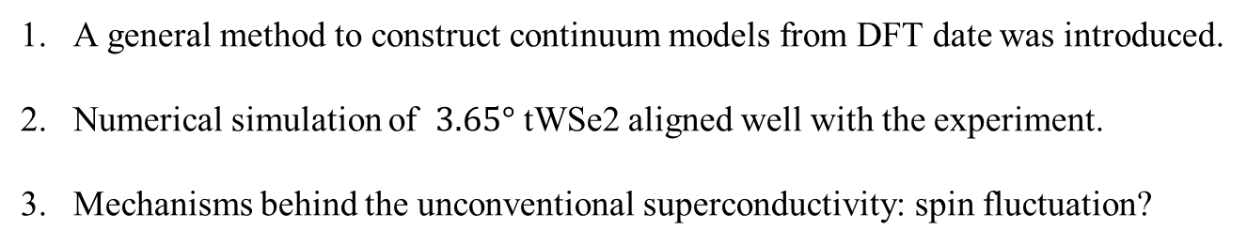
Conclusion and Outlook
A general method to construct continuum models from DFT date was introduced.
Numerical simulation of $3.65°$ tWSe2 aligned well with the experiment.
Mechanisms behind the unconventional superconductivity: spin fluctuation?
Thank you for your attention!

